Slide 1
Chapter 16
Methodology
Conceptual Database Design
Pearson Education © 2009

Slide 2
Chapter 16 - Objectives
The purpose of a design methodology.
Database design has three main phases: conceptual, logical, and physical design.
How to decompose the scope of the design into specific views of the enterprise.
Pearson Education © 2009

Slide 3
Chapter 16 - Objectives
How to use Entity–Relationship (ER) modeling to build a conceptual data model based on the data requirements of an enterprise.
How to validate the resultant conceptual model to ensure it is a true and accurate representation of the data requirements enterprise.
Pearson Education © 2009

Slide 4
Chapter 16 - Objectives
How to document the process of conceptual database design.
End-users play an integral role throughout the process of conceptual database design.
Pearson Education © 2009

Slide 5
Design Methodology
A structured approach that uses procedures, techniques, tools, and documentation aids to support and facilitate the process of design.
Pearson Education © 2009

Slide 6
Database Design Methodology
Three main phases
Conceptual database design
Logical database design
Physical database design
Pearson Education © 2009

Slide 7
Conceptual Database Design
The process of constructing a model of the data used in an enterprise, independent of all physical considerations.
Pearson Education © 2009

Slide 8
Logical Database Design
The process of constructing a model of the data used in an enterprise based on a specific data model (e.g. relational), but independent of a particular DBMS and other physical considerations.
Pearson Education © 2009

Slide 9
Physical Database Design
The process of producing a description of the implementation of the database on secondary storage; it describes the base relations, file organizations, and indexes used to achieve efficient access to the data, and any associated integrity constraints and security measures.
Pearson Education © 2009

Slide 10
Critical Success Factors in Database Design
Work interactively with the users as much as possible.
Follow a structured methodology throughout the data modeling process.
Employ a data-driven approach.
Incorporate structural and integrity considerations into the data models.
Combine conceptualization, normalization, and transaction validation techniques into the data modeling methodology.
Pearson Education © 2009

Slide 11
Critical Success Factors in Database Design
Use diagrams to represent as much of the data models as possible.
Use a Database Design Language (DBDL) to represent additional data semantics.
Build a data dictionary to supplement the data model diagrams.
Be willing to repeat steps.
Pearson Education © 2009

Slide 12
Overview Database Design Methodology
Conceptual database design
Step 1 Build conceptual data model
Step 1.1 Identify entity types
Step 1.2 Identify relationship types
Step 1.3 Identify and associate attributes with entity or relationship types
Step 1.4 Determine attribute domains
Step 1.5 Determine candidate, primary, and alternate key attributes
Pearson Education © 2009

Slide 13
Overview Database Design Methodology
Step 1 Build conceptual data model (continue)
Step 1.6 Consider use of enhanced modeling concepts (optional step)
Step 1.7 Check model for redundancy
Step 1.8 Validate conceptual model against user transactions
Step 1.9 Review conceptual data model with user
Pearson Education © 2009

Slide 14
Overview Database Design Methodology
Logical database design for the relational model
Step 2 Build and validate logical data model
Step 2.1 Derive relations for logical data model
Step 2.2 Validate relations using normalization
Step 2.3 Validate relations against user transactions
Step 2.4 Define integrity constraints
Pearson Education © 2009

Slide 15
Overview Database Design Methodology
Step 2 Build and validate logical data model (continue)
Step 2.5 Review logical data model with user
Step 2.6 Merge logical data models into global model (optional step)
Step 2.7 Check for future growth
Pearson Education © 2009

Slide 16
Overview Database Design Methodology
Physical database design for relational database
Step 3 Translate logical data model for target DBMS
Step 3.1 Design base relations
Step 3.2 Design representation of derived data
Step 3.3 Design general constraints
Pearson Education © 2009

Slide 17
Overview Database Design Methodology
Step 4 Design file organizations and indexes
Step 4.1 Analyze transactions
Step 4.2 Choose file organization
Step 4.3 Choose indexes
Step 4.4 Estimate disk space requirements
Pearson Education © 2009

Slide 18
Overview Database Design Methodology
Step 5 Design user views
Step 6 Design security mechanisms
Step 7 Consider the introduction of controlled redundancy
Step 8 Monitor and tune the operational system
Pearson Education © 2009

Slide 19
Step 1 Build Conceptual Data
To build a conceptual data model of the data requirements of the enterprise.
Model comprises entity types, relationship types, attributes and attribute domains, primary and alternate keys, and integrity constraints.
Step 1.1 Identify entity types
To identify the required entity types.
Step 1.2 Identify relationship types
To identify the important relationships that exist between the entity types.
Pearson Education © 2009

Slide 20
Step 1 Build Conceptual Data
Step 1.3 Identify and associate attributes with entity or relationship types
To associate attributes with the appropriate entity or relationship types and document the details of each attribute.
Step 1.4 Determine attribute domains
To determine domains for the attributes in the data model and document the details of each domain.
Pearson Education © 2009

Slide 21
Step 1 Build Conceptual Data
Step 1.5 Determine candidate, primary, and alternate key attributes
To identify the candidate key(s) for each entity and if there is more than one candidate key, to choose one to be the primary key and the others as alternate keys.
Step 1.6 Consider use of enhanced modeling concepts (optional step)
To consider the use of enhanced modeling concepts, such as specialization / generalization, aggregation, and composition.
Pearson Education © 2009

Slide 22
Step 1 Build Conceptual Data Model
Step 1.7 Check model for redundancy
To check for the presence of any redundancy in the model and to remove any that does exist.
Step 1.8 Validate conceptual model against user transactions
To ensure that the conceptual model supports the required transactions.
Step1.9 Review conceptual data model with user
To review the conceptual data model with the user to ensure that the model is a ‘true’ representation of the data requirements of the enterprise.
Pearson Education © 2009

Slide 23
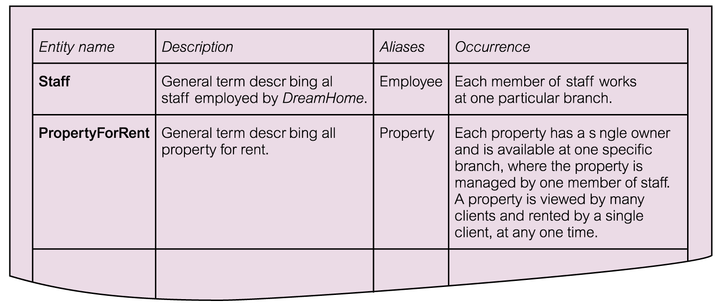
Extract from data dictionary for Staff user views of DreamHome showing description of entities
Pearson Education © 2009

Slide 24
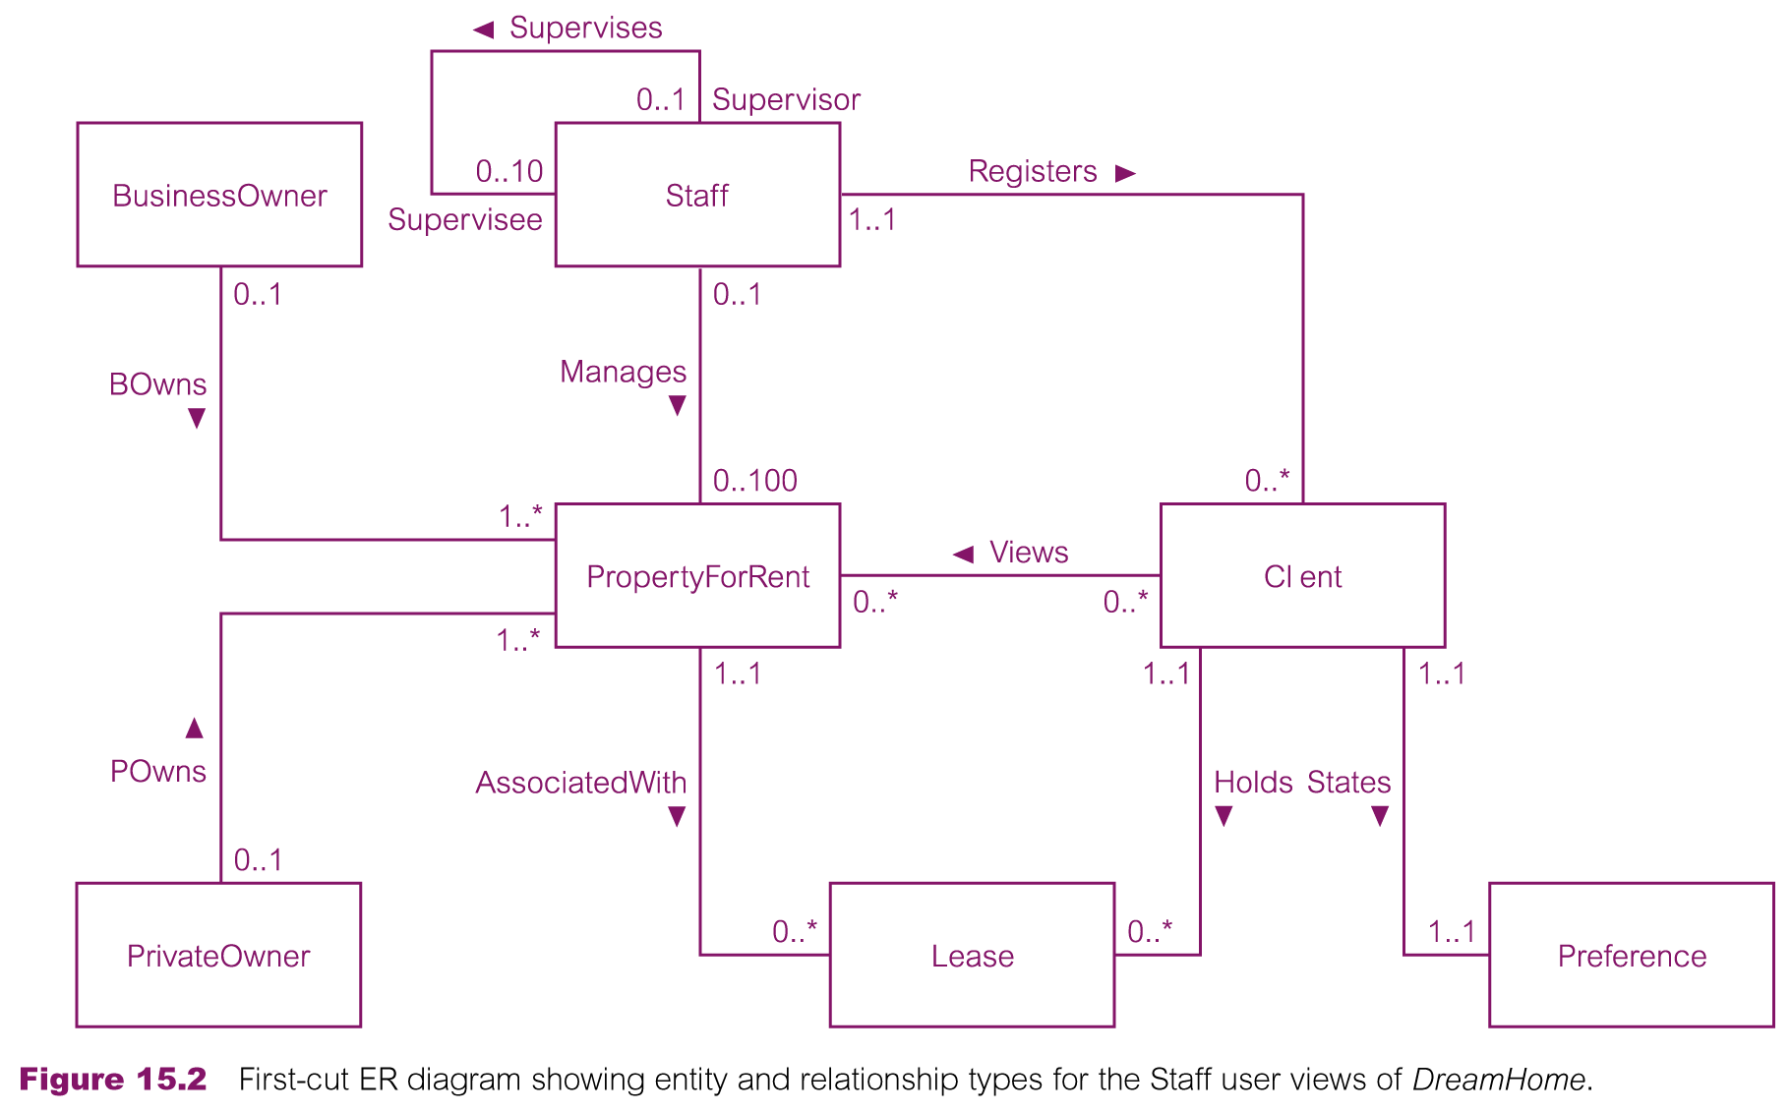
First-cut ER diagram for Staff user views of DreamHome
Pearson Education © 2009

Slide 25
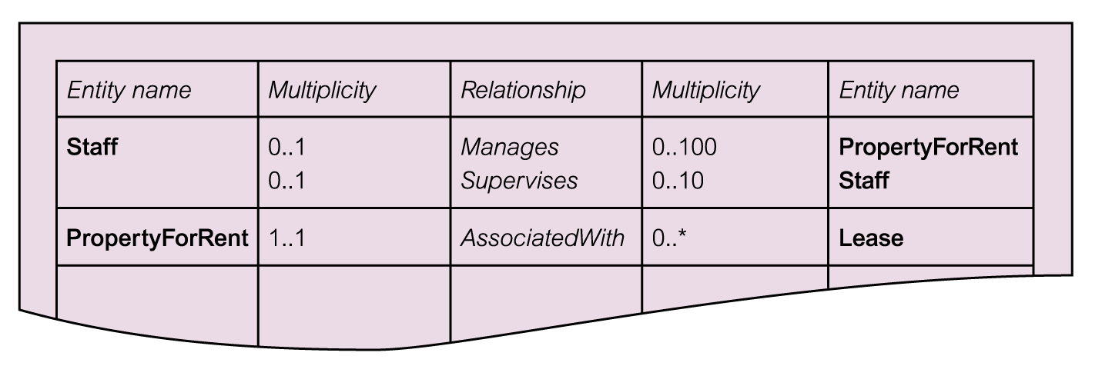
Extract from data dictionary for Staff user views of DreamHome showing description of relationships
Pearson Education © 2009

Slide 26
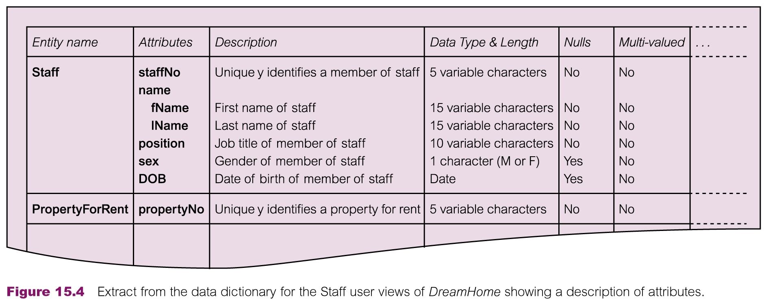
Extract from data dictionary for Staff user views of DreamHome showing description of attributes
Pearson Education © 2009

Slide 27
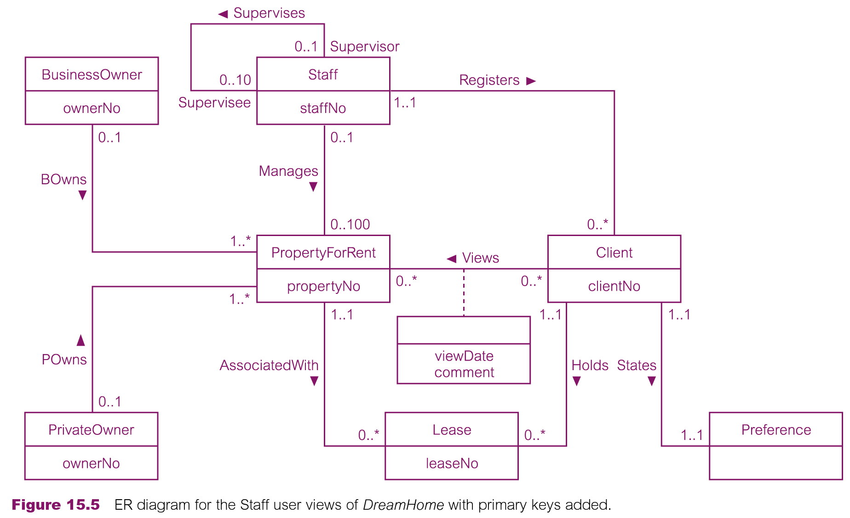
ER diagram for Staff user views of DreamHome with primary keys added
Pearson Education © 2009

Slide 28
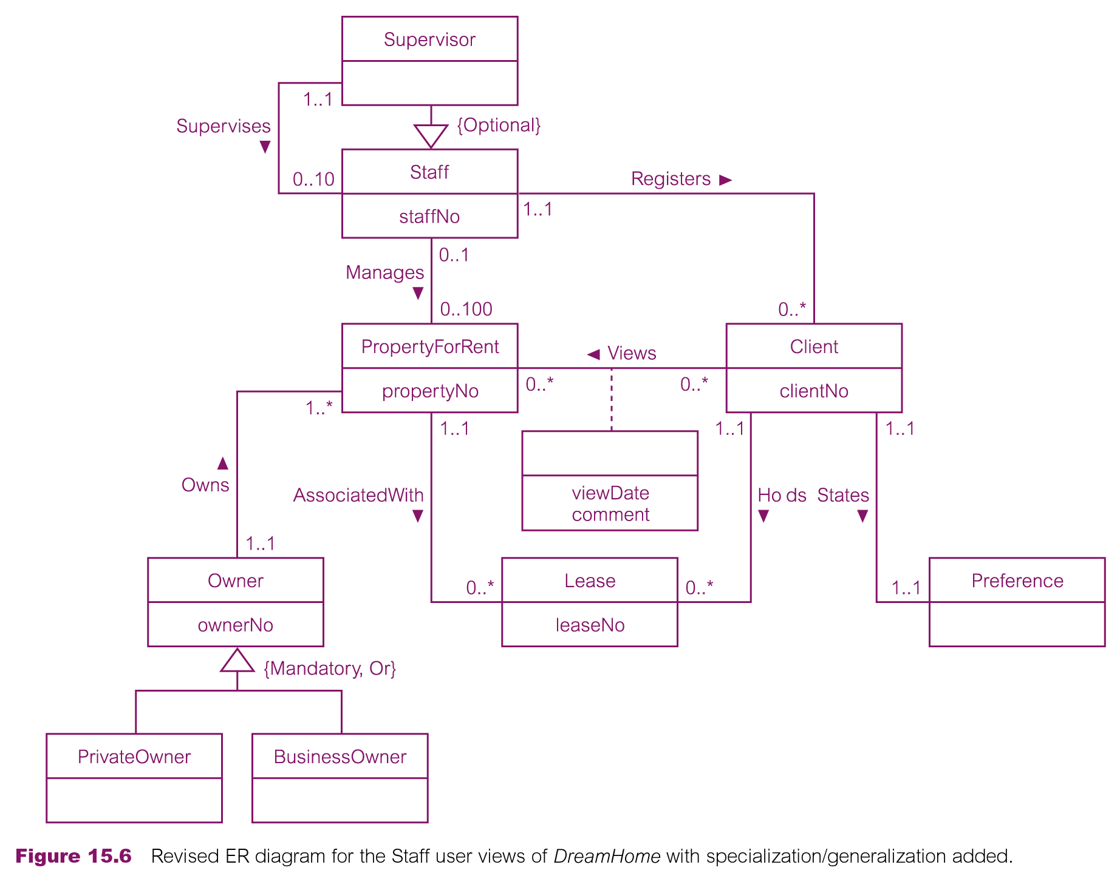
Revised ER diagram for Staff user views of DreamHome with specialization / generalization
Pearson Education © 2009

Slide 29
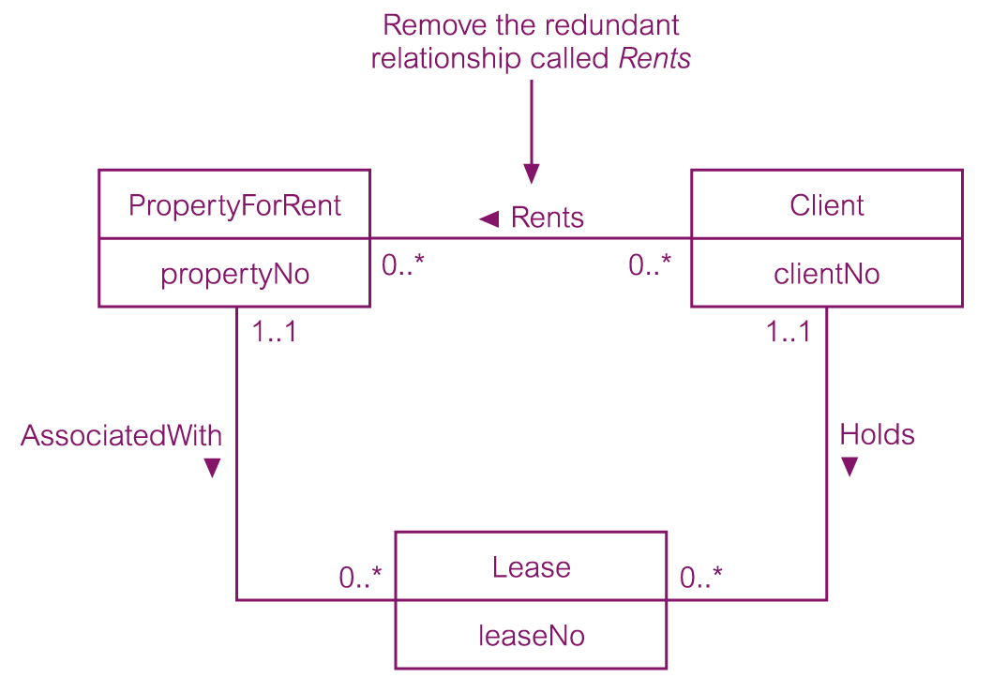
Example of removing a redundant relationship called Rents
Pearson Education © 2009

Slide 30
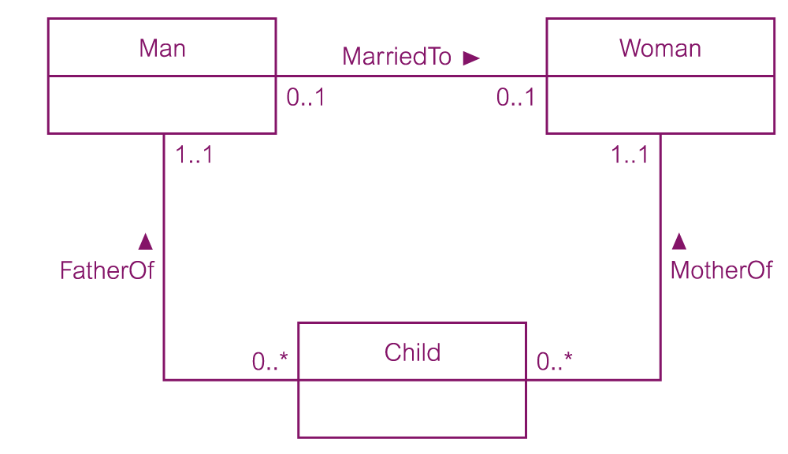
Example of a non-redundant relationship FatherOf
Pearson Education © 2009

Slide 31
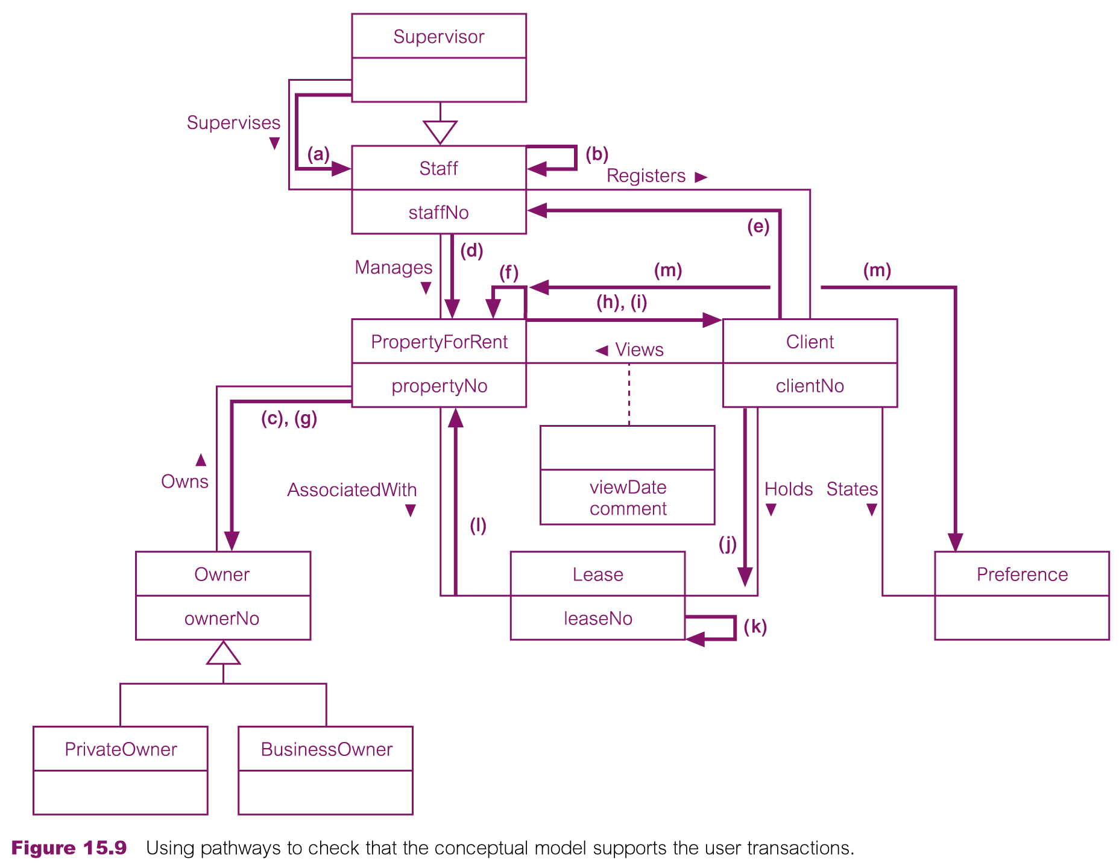
Using pathways to check that the conceptual model supports the user transactions
Pearson Education © 2009

